Slide 1

Use case: Phosphorus G.UNI
OGF24 NSI-WG
Singapore
15 September 2008
Eduard Escalona

Slide 2
G.UNI Objectives
Interconnect Grid layer to Grid enabled GMPLS Control Plane (G²MPLS)
Capable of providing network services
  Con. Creation, Con. Deletion, Con. Status
  Support of different connection types
  Neighbour and Service Discovery
  Network Advance Reservations
  Security
Flexible and extensible

Slide 3

Phosphorus G.UNI
UNICORE MW
WSAG based API
WSAG server
BES based API
BES Server
IDL
UNI-C
UNI-N

Slide 4
OGSA-Basic Execution Service
OGSA-BES: OGF driven OGSA Standard Web Services interface for creating and managing computational jobs.
Uses jsdl documents.
Phosphorus implements extensions to support Network specific parameters
  TNAs
  Network Advance Reservations
  Bandwidth

Slide 5
G.UNI Operations
Create Activity:
  Input: jobID, Service Type, TNAs, Bandwidth, Start Time, End Time
  Output: Activity Identifier
Terminate Activity:
  Input: jobID, Activity Identifier
  Output: ACK
Get Activity Status:
  Input: jobID, Activity Identifier
  Output: Status

Slide 6



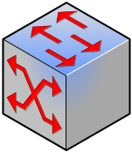
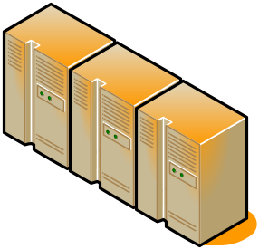

Vsite A
Vsite B
Grid user
G²
G²
G.OUNI
GW
G.OUNI
GW
G²
G²
G²
G²
Grid
MW
G²
Grid
MW
G²MPLS NCP
DIRECT INVOCATION
Grid
Resources
Grid
Resources

Slide 7
G.OUNI
GW
Grid
MW
Grid user
Vsite A
Vsite C
Vsite B
G²
G²
G.OUNI
GW
G.OUNI
GW
G²
G²
G²
G²
Grid
MW
G²
Grid
MW
G²MPLS NCP
INDIRECT INVOCATION
Grid
Resources
Grid
Resources

Slide 8
NSI in G.UNI?
UNICORE MW
NSI
WSAG based API
WSAG server
BES based API
BES Server
IDL
UNI-C
UNI-N

